Slide 1
Physical Chemistry III
2022.03.21

Slide 2
Index of contents
Schrödinger equation – History
Bra-ket notation
Particle in a box

Slide 3
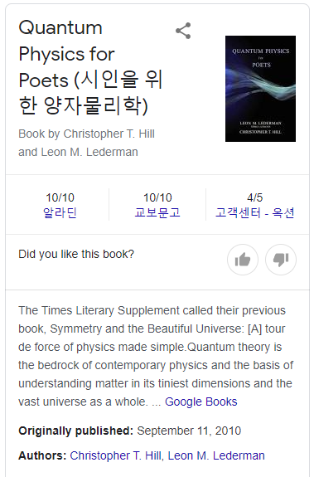

Slide 4
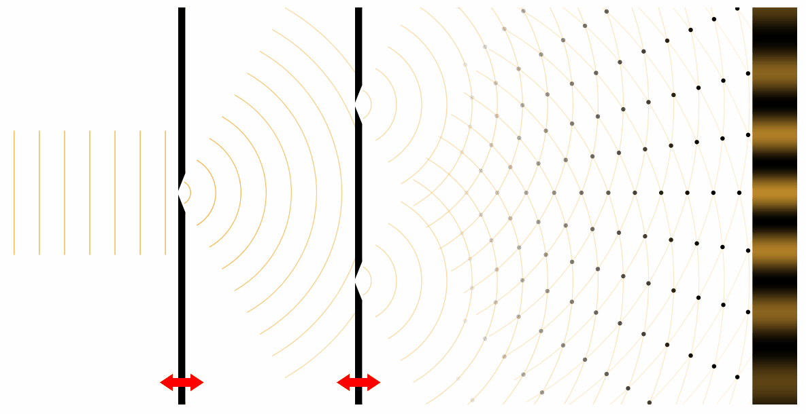
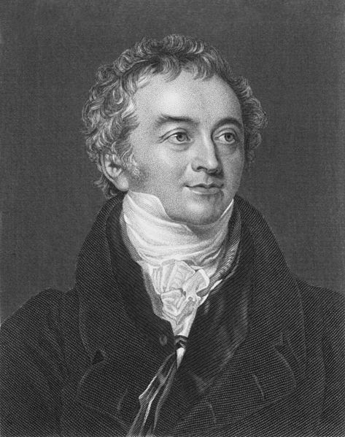
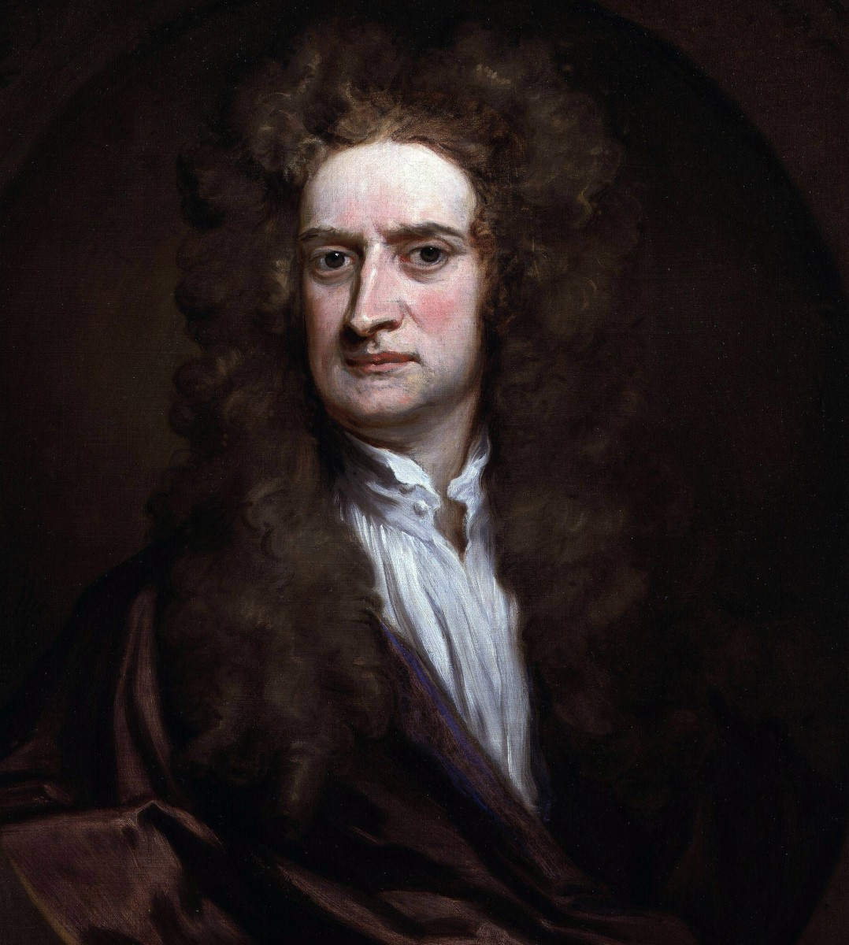
Double slit experiment
Light is made up of small discrete particles!
In 1801, Thomas Young
https://javalab.org/en/youngs_double_slit_en/
No. You wrong.
Light is wave.

Slide 5
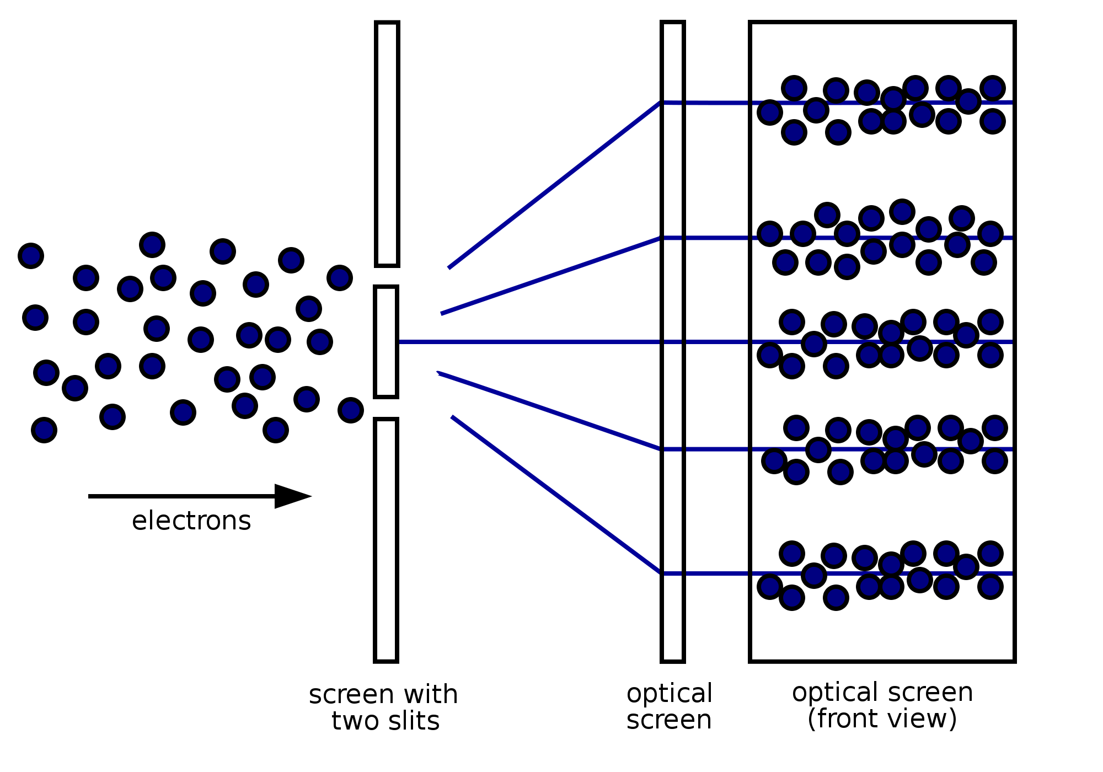
Double slit experiment
In 1801, Thomas Young
In 1927 at Bell Labs, Clinton Davisson and Lester Germer
https://javalab.org/en/youngs_double_slit_en/
Electron is wave..?

Slide 6
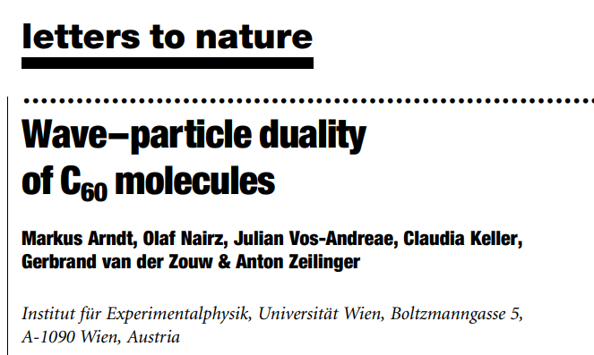
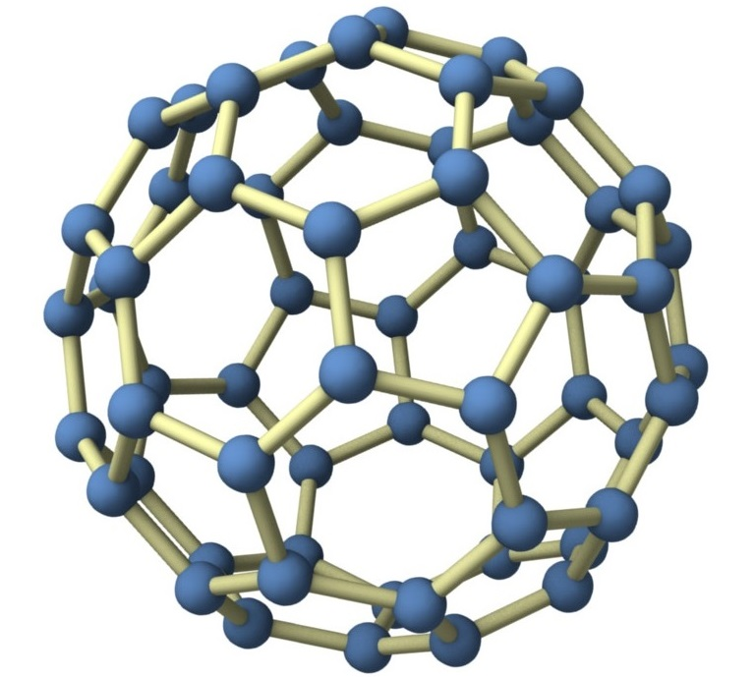
Double slit experiment
In 1801, Thomas Young
https://javalab.org/en/youngs_double_slit_en/
Am I wave?

Slide 7
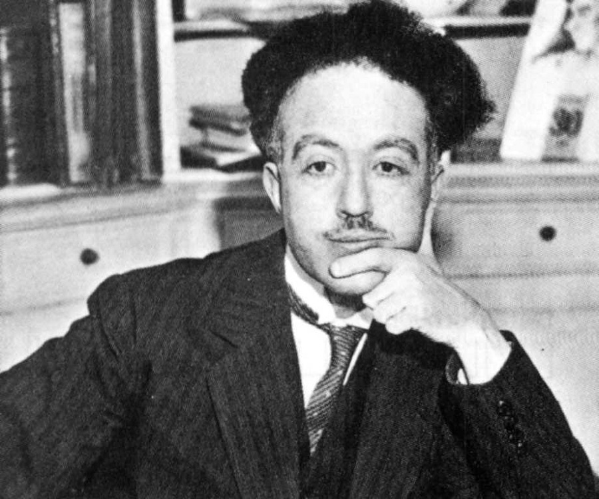
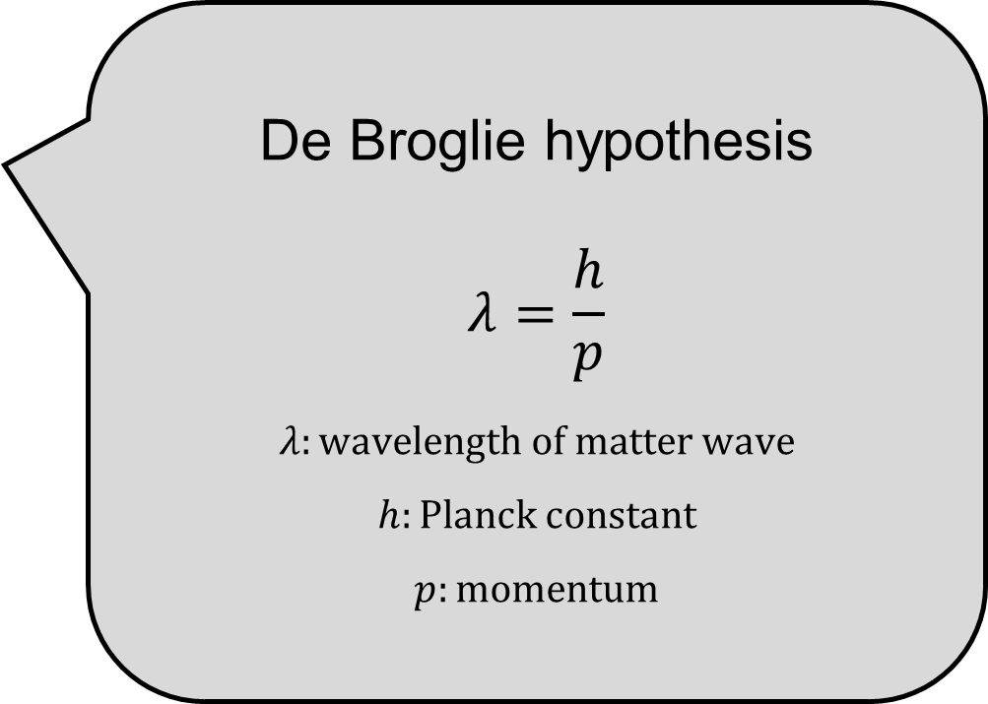
Matter wave
In 1924, De Broglie (Ph.D student)
De Broglie hypothesis
$$λ=\frac{h}{p}$$
$$λ:wavelength of matter wave$$
$$h:Planck constant$$
$$p:momentum$$

Slide 8
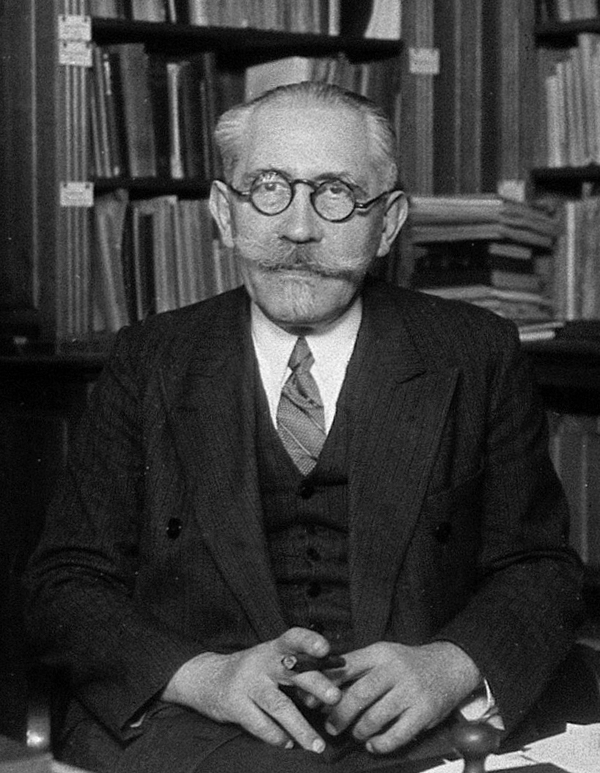
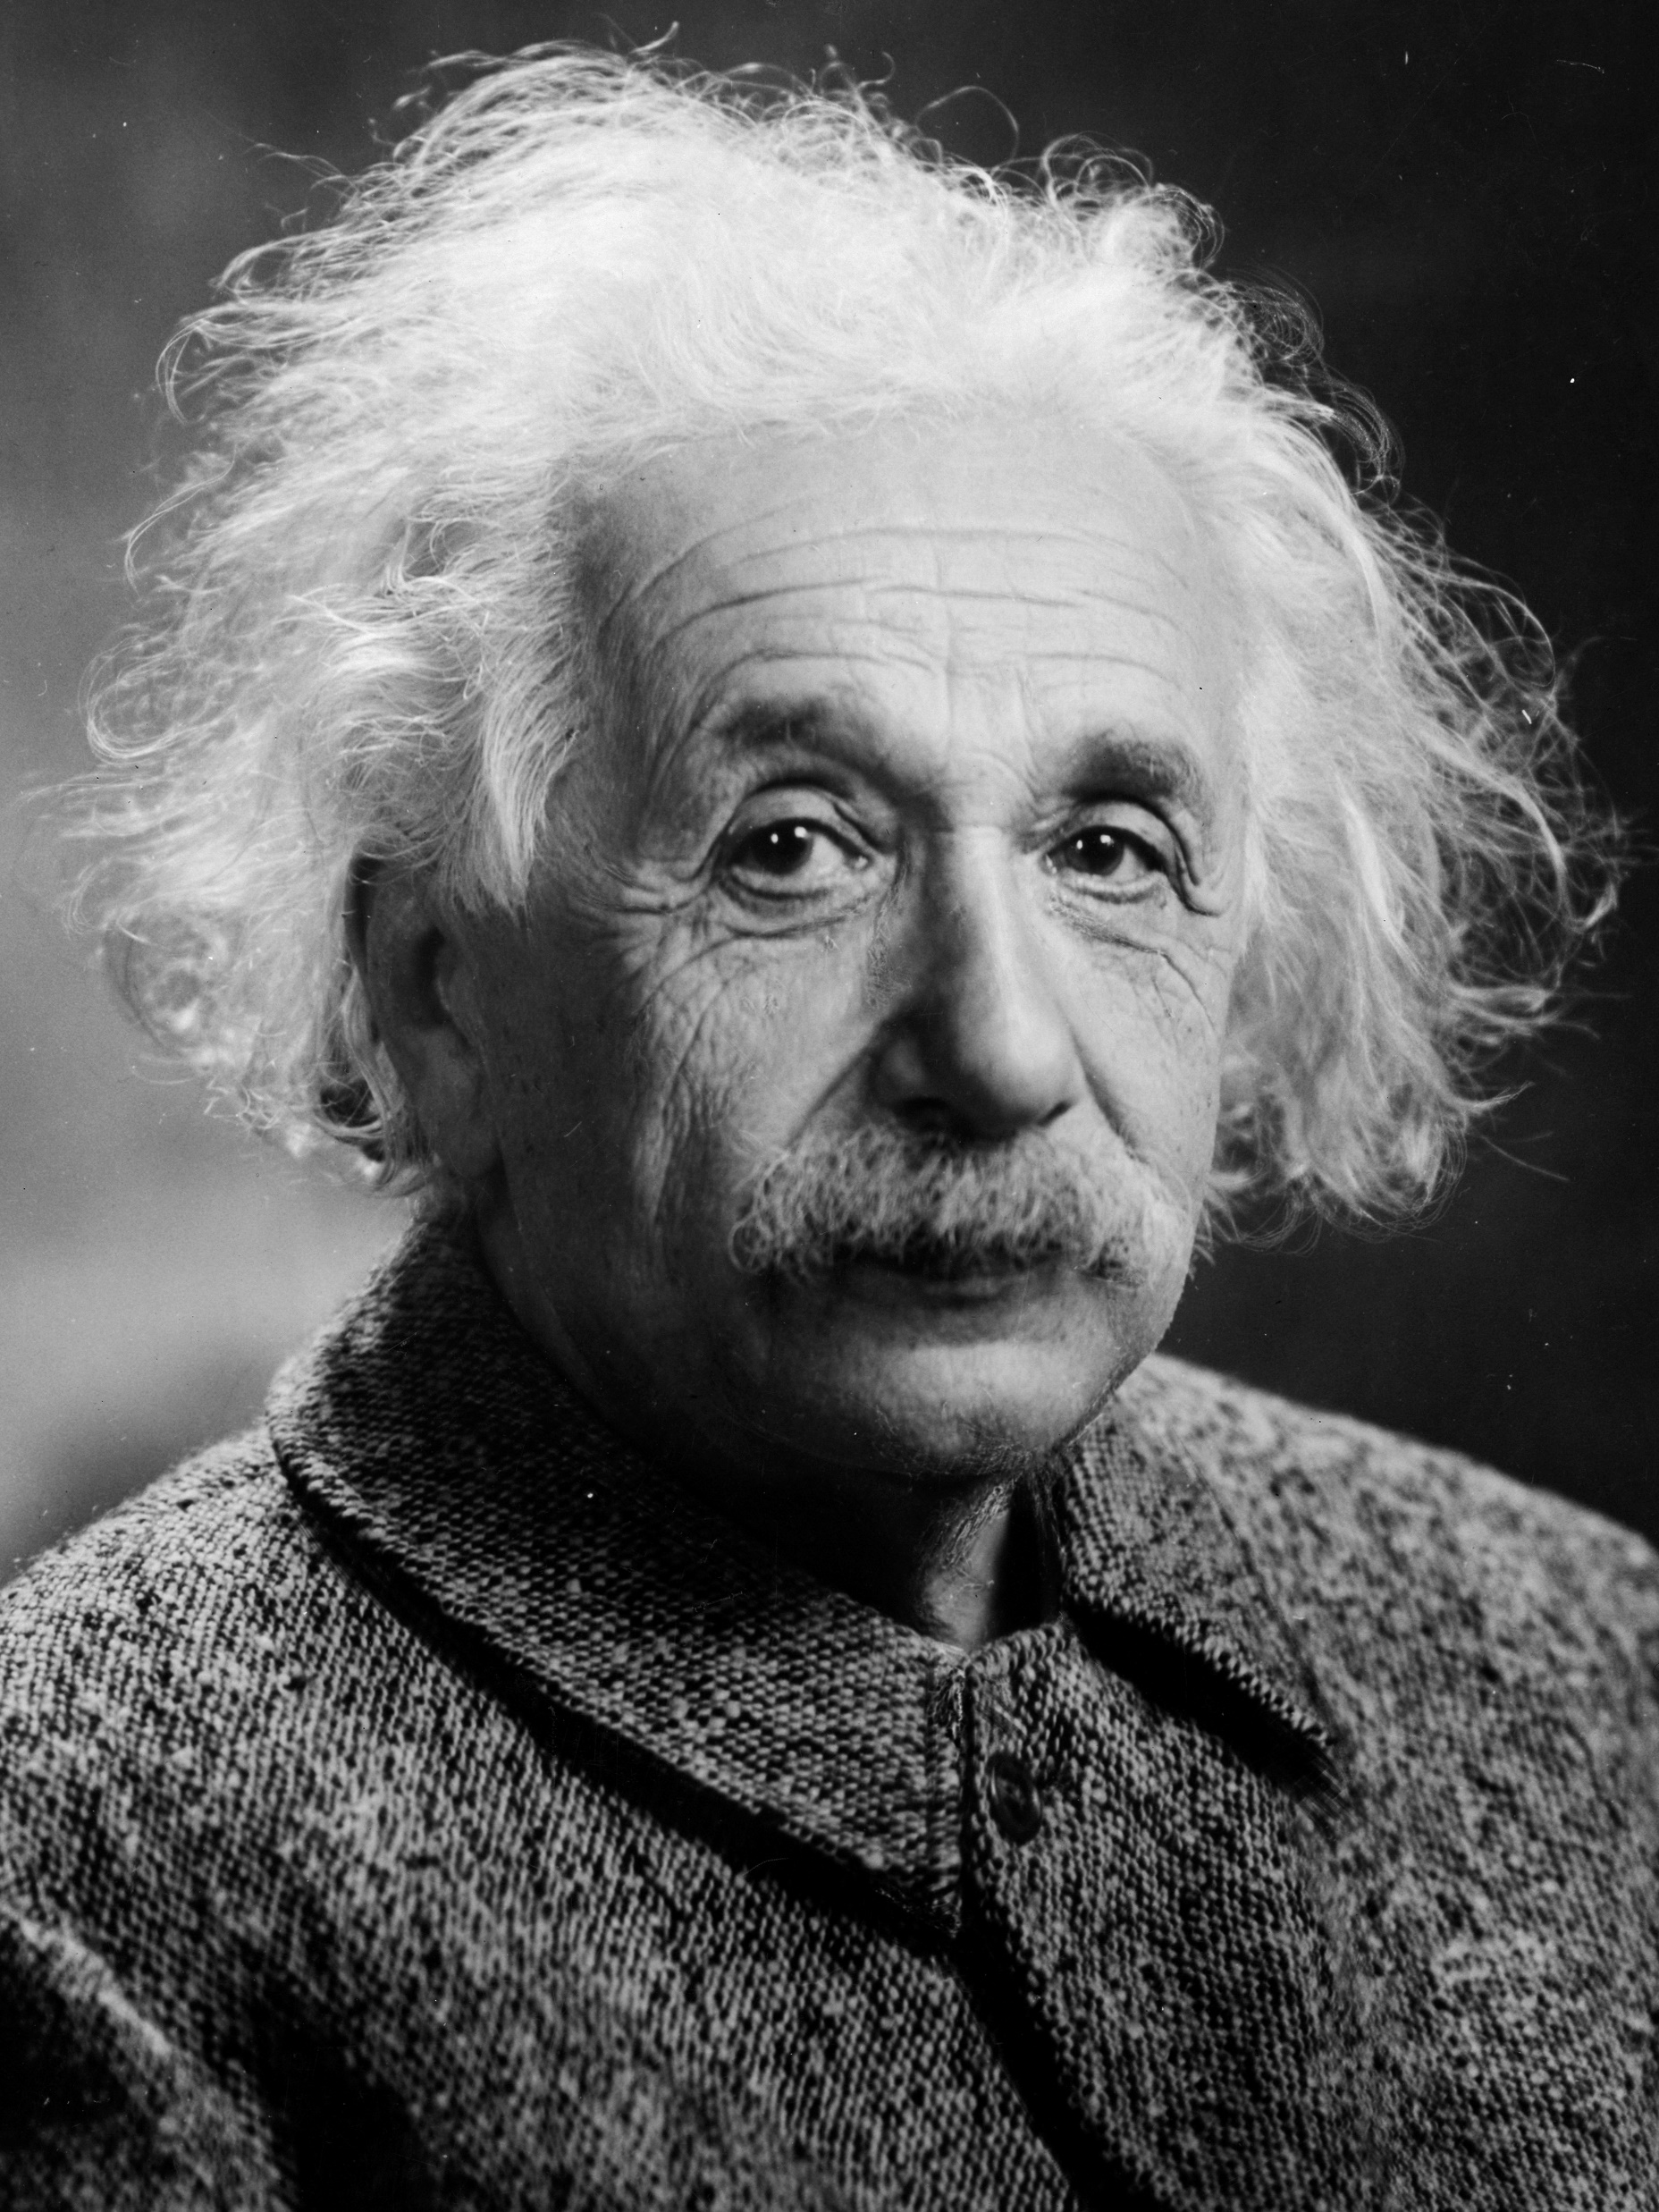
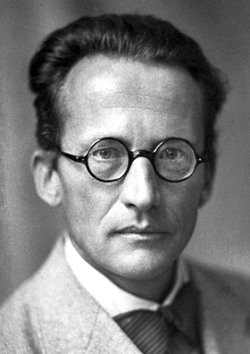
Matter wave
Paul Langevin (Professor of Broglie)
Albert Einstein (Friend of Langevin)
De Broglie (Ph.D student)
Erwin Schrödinger (Research assistant of Einstein)

Slide 9
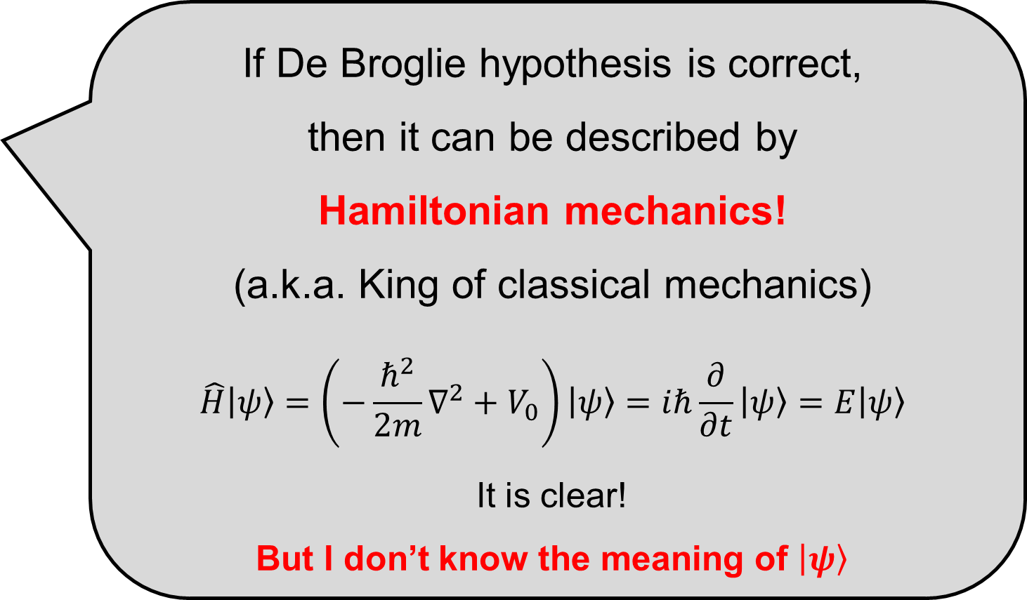
Schrödinger Equation
In 1925, (published in 1926)
If De Broglie hypothesis is correct,
then it can be described by
Hamiltonian mechanics!
(a.k.a. King of classical mechanics)
$$\hat{H}\left|ψ\right\rangle =\left(−\frac{ℏ^{2}}{2m}∇^{2}+V_{0}\right)\left|ψ\right\rangle =iℏ\frac{∂}{∂t}\left|ψ\right\rangle =E\left|ψ\right\rangle$$
It is clear!
But I don’t know the meaning of $\left|ψ\right\rangle$

Slide 10
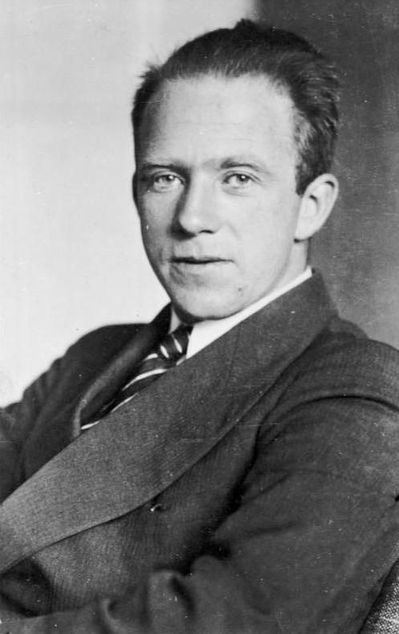
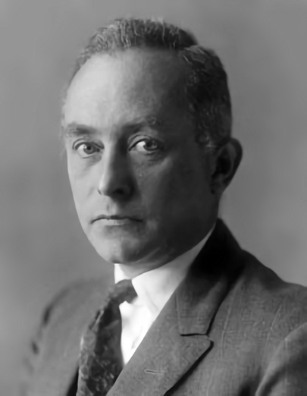
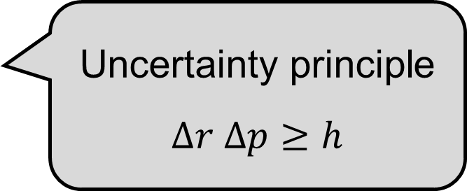
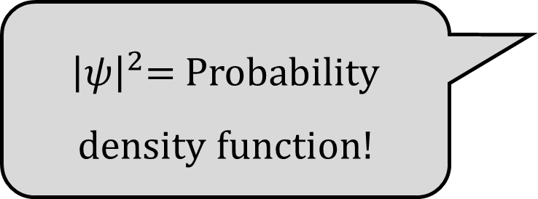
After Schrödinger Equation
In 1926,
Uncertainty principle
$$∆r ∆p≥h$$
${\left|ψ\right|}^{2}$= Probability density function!
Werner Heisenberg
Max Born

Slide 11
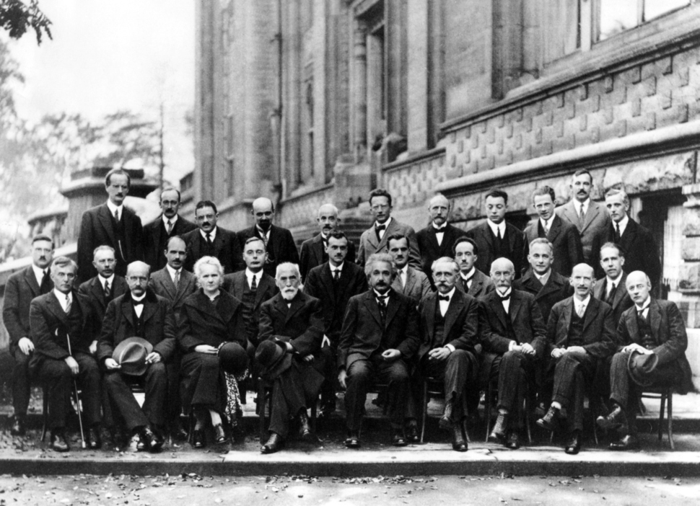
After Schrödinger Equation
Erwin Schrödinger
Werner Heisenberg
In 1927 Brussels conference..
De Broglie
Max Born
Albert Einstein
Paul Langevin

Slide 12
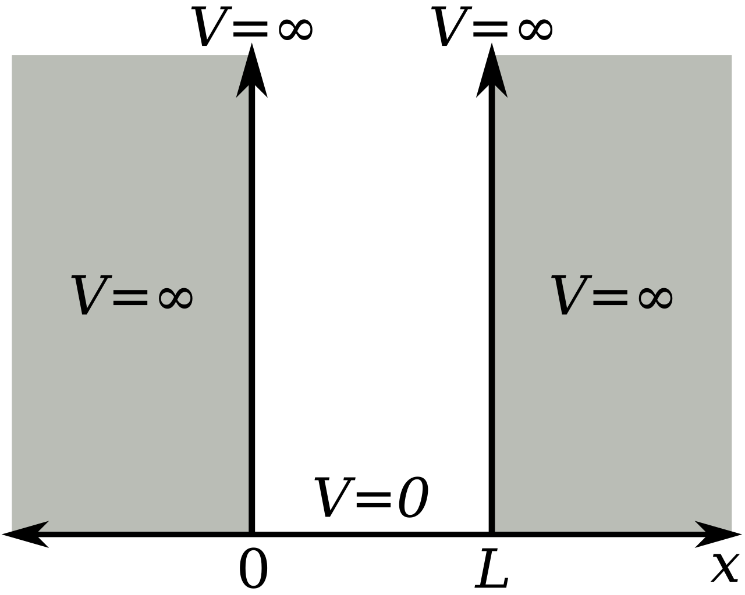
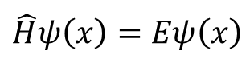
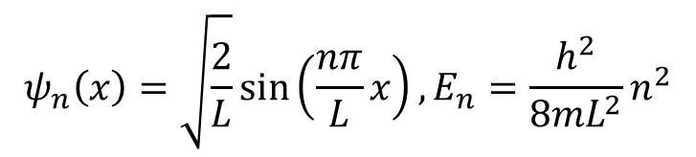
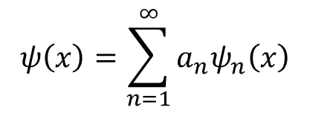
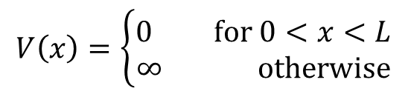
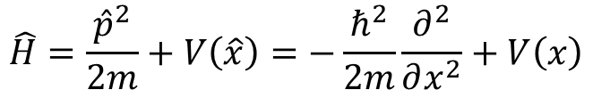
Particle in a box
$$\hat{H}ψ\left(x\right)=Eψ\left(x\right)$$
$$\hat{H}=\frac{{\hat{p}}^{2}}{2m}+V\left(\hat{x}\right)=−\frac{ℏ^{2}}{2m}\frac{∂^{2}}{∂x^{2}}+V\left(x\right)$$
$$V\left(x\right)=\left\{\begin{aligned}0 for 0<x<L \\ ∞ otherwise\end{aligned}\right.$$
$$ψ\left(x\right)=\sum_{n=1}^{∞}{a_{n}ψ_{n}\left(x\right)}$$
$$ψ_{n}\left(x\right)=\sqrt{\frac{2}{L}}\sin\left(\frac{nπ}{L}x\right), E_{n}=\frac{h^{2}}{8mL^{2}}n^{2}$$
https://github.com/thereexist/Physical_chemistry_3/blob/main/Particle_in_a_box/particle_in_a_box.ipynb

Slide 13
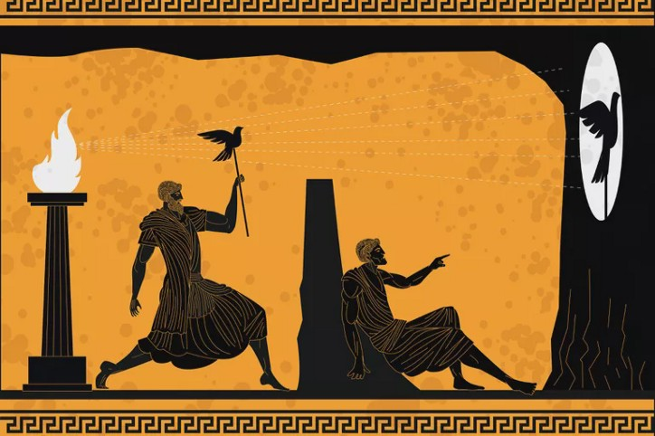
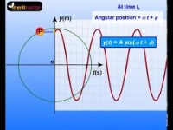
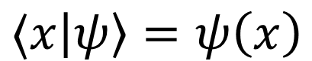
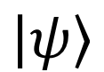
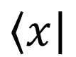
$$\left\langle x\right|$$
$$\left|ψ\right\rangle$$
$$⟨x\left|ψ\right\rangle =ψ\left(x\right)$$

Slide 14

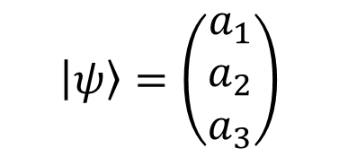
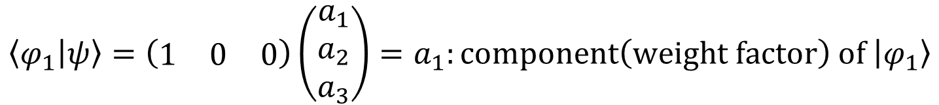
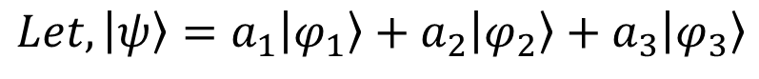
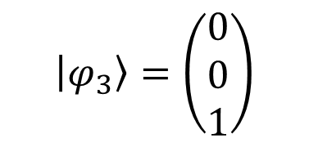
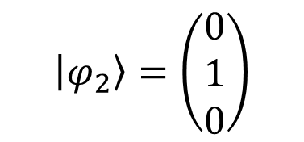
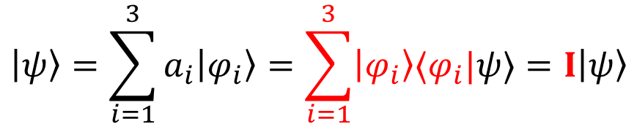
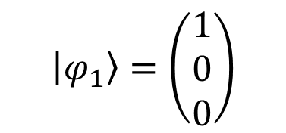
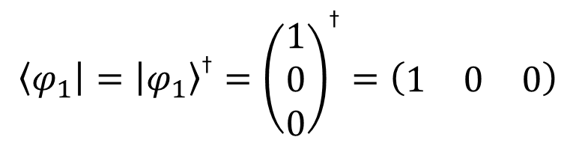
$$Let, \left|ψ\right\rangle =a_{1}\left|φ_{1}\right\rangle +a_{2}\left|φ_{2}\right\rangle +a_{3}\left|φ_{3}\right\rangle$$
$$\left|φ_{1}\right\rangle =\left(\begin{matrix}1 \\ 0 \\ 0\end{matrix}\right)$$
$$\left|φ_{2}\right\rangle =\left(\begin{matrix}0 \\ 1 \\ 0\end{matrix}\right)$$
$$\left|φ_{3}\right\rangle =\left(\begin{matrix}0 \\ 0 \\ 1\end{matrix}\right)$$
Orthonormal basis
$$\left|ψ\right\rangle =\left(\begin{matrix}a_{1} \\ a_{2} \\ a_{3}\end{matrix}\right)$$
$$\left\langle φ_{1}\right|={\left|φ_{1}\right\rangle }^{\text{†}}={\left(\begin{matrix}1 \\ 0 \\ 0\end{matrix}\right)}^{\text{†}}=\left(\begin{matrix}1 & 0 & 0\end{matrix}\right)$$
$$a_{1}^{ 2}+a_{2}^{ 2}+a_{3}^{ 2}=1$$
$$\left\langle φ_{1} | ψ\right\rangle =\left(\begin{matrix}1 & 0 & 0\end{matrix}\right)\left(\begin{matrix}a_{1} \\ a_{2} \\ a_{3}\end{matrix}\right)=a_{1}:component\left(weight factor\right) of \left|φ_{1}\right\rangle$$
$$\left|ψ\right\rangle =\sum_{i=1}^{3}{a_{i}\left|φ_{i}\right\rangle }=\sum_{i=1}^{3}{\left|φ_{i}\right\rangle ⟨φ_{i}|ψ⟩}=I\left|ψ\right\rangle$$

Slide 15
$$\left\langle x\right|$$
$$\left|ψ\right\rangle$$
$$⟨x\left|ψ\right\rangle =ψ\left(x\right)$$

